Slide 1
Object-oriented Principles
Bence Olah

Slide 2
Agenga
Introduction: Software quality
Designing UML Class diagram for the traveling domain
Discussing the solution at the whiteboard
Learning Object Oriented Principles
Implementing the solution

Slide 3
Software quality
External factors
Correctness – perform the exact tasks defined by the specification
Robustness – react appropriately to abnormal conditions
Extendibility – adaptability to changes of specification
Maintainability – ease of modification, understandability
Reusability – elements serve for the construction of different applications
Functionality – extent of possibilities provided by a system
Compatibility, portability, ease of use
Performance

Slide 4
Problem statement
Passengers book trips for certain flights. The flights are selected based on flight date and fare. The fare depends on itinerary, booking class and booking date.
Passengers pay the tickets. Before each leg they check in when get their seat and also check the luggage in.
Multiple passengers can form a group. They can book and cancel their trips and can get discount and point based on their current frequent flyer category. The points can be used for paying the tickets.

Slide 5
Basic requirements
Use cases
Passanger(s) can pay the tickets
Passanger(s) can collect miles points for a trip
Passanger(s) can get discount based on Frequent Flier program
Passanger gets promoted if enough miles points are collected

Slide 6
Resulting class diagram
Passenger
1..*
Passenger
Group
0..*
Trip
1..*
Flight Ticket
Itinerary
Miles state
1..*
1
1
Flight
FF Program
OccasionalFlier
FrequentFlier

Slide 7
Core OO concepts
Encapsulation - information hiding
Abstraction
Inheritance
Polymorphism
Notes:
Encapsulation - Information hiding
„Tell, don’t ask” principle:
Clients of a class should not directly access or modify its internal state, instead they tell the objects what operation to perform.
This way the clients do not depend on the implementation of the state and/or the objects' relations.
Procedural code gets information then makes decisions. Object-oriented code tells objects to do things.
Information hiding
hiding of critical design decision, e.g. data structure
Encapsulation
The language facility that bundles data with the operations that perform on that data is encapsulation.
Why getter and setter methods are evil
http://www.javaworld.com/javaworld/jw-09-2003/jw-0905-toolbox.html?page=3
GetterEradicator
http://martinfowler.com/bliki/GetterEradicator.html
Getters and setters bad design
http://artur.ejsmont.org/blog/content/why-are-setters-and-getters-bad-for-object-oriented-design
Example:
A common use of information hiding is to hide the physical storage layout for data so that if it is changed, the change is restricted to a small subset of the total program. For example, if a three-dimensional point (x,y,z) is represented in a program with three floating point scalar variables and later, the representation is changed to a single array variable of size three, a module designed with information hiding in mind would protect the remainder of the program from such a change.
Example 2
For instance, a car manufacturer may have a luxury version of the car as well as a standard version. The luxury version comes with a more powerful engine than the standard version. The engineers designing the two different car engines, one for the luxury version and one for the standard version, provide the same interface for both engines. Both engines fit into the engine bay of the car which is the same between both versions. Both engines fit the same transmission, the same engine mounts, and the same controls. The differences in the engines are that the more powerful luxury version has a larger displacement with a fuel injection system that is programmed to provide the fuel air mixture that the larger displacement engine requires.
Question 1:
Can you make massive changes to a class definition—even throw out the whole thing and replace it with a completely different implementation—without impacting any of the code that uses that class's objects? This sort of modularization is the central premise of object orientation and makes maintenance much easier.

Slide 8
1. Encapsulation & information hiding
Encapsulation
Bundle data with the operations
Information hiding
Protect components of the object from external entities
Encapsulating internal concepts
Hiding implementation details
Tell, don’t ask principle: instance variables not exposed
Example: Frequent flier program point calculation
Law of Demeter principle: don't talk to strangers
Example: Calculate discount
Notes:
Encapsulation - Information hiding
„Tell, don’t ask” principle:
Clients of a class should not directly access or modify its internal state, instead they tell the objects what operation to perform.
This way the clients do not depend on the implementation of the state and/or the objects' relations.
Procedural code gets information then makes decisions. Object-oriented code tells objects to do things.
Why getter and setter methods are evil
http://www.javaworld.com/javaworld/jw-09-2003/jw-0905-toolbox.html?page=3
GetterEradicator
http://martinfowler.com/bliki/GetterEradicator.html
Getters and setters bad design
http://artur.ejsmont.org/blog/content/why-are-setters-and-getters-bad-for-object-oriented-design
Performance is not a reason to avoid getters/setters!!
Example:
money.getValue() + money2.getValue()
But later new currency is added to the system
Problem: money(huf).getValue() + money(usd).getValue() is invalid
Solution: Money.add(Money) method
Question 1:
Can you make massive changes to a class definition—even throw out the whole thing and replace it with a completely different implementation—without impacting any of the code that uses that class's objects? This sort of modularization is the central premise of object orientation and makes maintenance much easier.

Slide 9
2. Abstraction
Abstraction - object/class
Used for modeling a concept (real object or an idea)
Models state and behavior – attributes and methods
Abstraction also means generalization – class hierarchies
High cohesion of the associated data structures and methods
Independent classes are loosely coupled
Single responsibility principle
Stand-alone classes
Notes:
Classes are modeling „active” objects, implementing a consistent behavior related to a set of data and referred object hierarchies (direct and indirect collaborators). Examples:
An order can add/delete line items constituting the order, also can calculate some total values (billable price).
A car can turn right/left, accelerate or break.
Cohesion: A class has high cohesion when it is designed around a set of related functions, and low cohesion when designed around unrelated functions.
High cohesion in a class means that methods are operating on the whole internal state (most of the attributes):
The attributes are interrelated and the methods are changing them in a way that they always reach a consistent state as a result of the operation.
If you can separate some methods operation on a subset of the attributes, than this methods and attributes could be refactored to a separate class.
Coupling: Dependence on another class. Tight coupling is very dependent on other classes and makes a system monolithic and hard to change. Loose coupling leads to classes that can be reused.
Low coupling between classes means that they are independent:
Change in one class does not result in the change in the other class.
Single responsibility principle
In the context of the Single Responsibility Principle (SRP) we define a responsibility to be “a reason for change.” If you can think of more than one motive for changing a class, then that class has more than one responsibility. This is sometimes hard to see. We are accustomed to thinking of responsibility in groups.

Slide 10
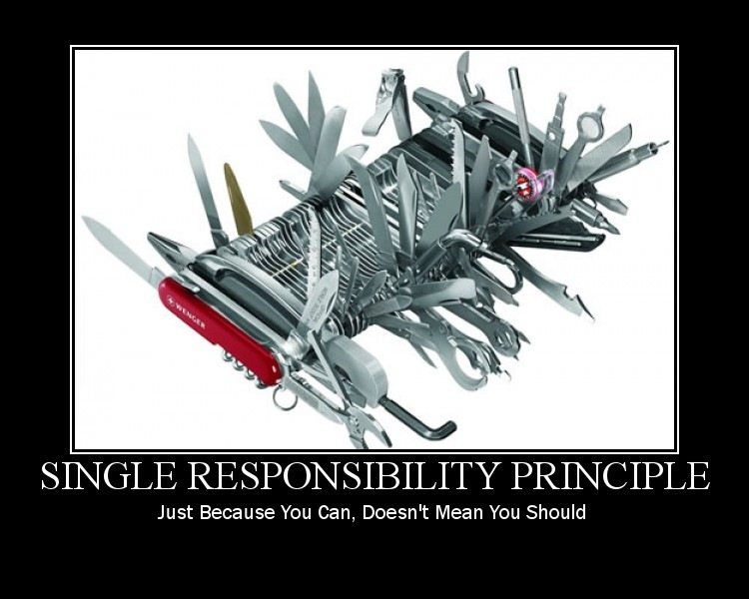
Single Responsibility Principle - SRP

Slide 11
Design by Contract
Design by Contract
Preconditions and postconditions (rights and obligations)
Assertion and violation (bug in client or supplier)
Class invariants (reference semantics of aggregates)
Client’s obligations
Provide input and contextual data with correct type and semantics
Must ensure that preconditions are satisfied
Notes:
Design by Contract
Viewing the relationship between a class and its clients as a formal agreement, expressing each party’s rights and obligations. Only through such a precise definition of every module’s claims and responsibilities can we hope to attain a significant degree of trust in large software systems.
http://se.ethz.ch/~meyer/publications/computer/contract.pdf
Invariant
In computer science, a predicate that, if true, will remain true throughout a specific sequence of operations, is called (an) invariant to that sequence.
Mars Orbitter
CNN NASA lost a 125 million Mars orbiter because one engineering team used metric units while another used English units for a key spacecraft operation, according to a review finding released Thursday.

Slide 12
Design by Contract
Supplier’s obligations
Provide a certain product
Supply data with correct type, semantics and sequence
Preserve invariants
Signal error conditions, logging and monitoring information
Must ensure that postconditions are satisfied
Notes:
Inheritance & design by contract
• A sub class should Honor the contracts made by it parent classes
• Pre-conditions can only get weaker
• Post-conditions can only get stronger

Slide 13
General principles in detail
Dependency inversion principle
High level components should not depend upon low level ones - Both should depend upon abstractions
Abstractions should not depend upon details - Details should depend upon abstractions
Implementation of the dependency inversion principle
Define abstract interfaces for low level components
Implement these interfaces for the concrete problem
Use the Template method design pattern
Notes:
Situation: project code depends on mysql, later on mysql will be changed postgresql –> create abstract interfacet for its

Slide 14
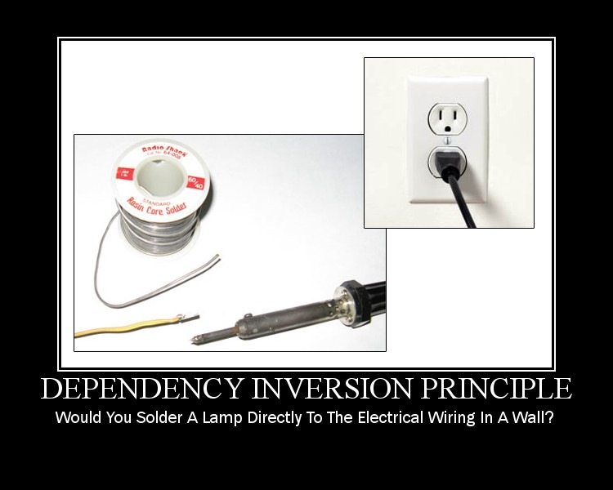
DIP

Slide 15
3. Polymorphism
Liskov's substitution principle
Imposes requirements on method signatures and behavior
Main role is to ensure that design by contract works
Constraints placed on subtypes
Method arguments must be more general
Return types must be more specific
No new exceptions should be thrown
Preconditions cannot be strengthened
Postconditions cannot be weakened
Invariants of the supertype must be preserved
New methods cannot change state (history constraint)
Notes:
Definition: Polymorphism
In object-oriented programming, polymorphism (from the Greek meaning "having
multiple forms") is the characteristic of being able to assign a different meaning to a
particular symbol or "operator" in different context
http://javarevisited.blogspot.hu/2012/03/what-is-static-and-dynamic-binding-in.html
Liskov's principle imposes some standard requirements on signatures that have been adopted in newer object-oriented programming languages:
Method arguments must be more general in the subtype.
Return types must be more specific in the subtype.
No new exceptions should be thrown by methods of the subtype, except where those exceptions are themselves subtypes of exceptions thrown by the methods of the supertype.
In addition to these, there is a number of behavioral conditions that subtype must meet. These are detailed in a terminology resembling that of design by contract methodology, leading to some restrictions on how contracts can interact with inheritance:
Preconditions cannot be strengthened in a subtype.
Postconditions cannot be weakened in a subtype.
Invariants of the supertype must be preserved in a subtype.
History constraint (the "history rule"). Objects are regarded as being modifiable only through their methods (encapsulation). Since subtypes may introduce methods that are not present in the supertype, the introduction of these methods may allow state changes in the subtype that are not permissible in the supertype. The history constraint prohibits this. This was the novel element introduced by Liskov and Wing.
A violation of this constraint can be exemplified by defining a MutablePoint as a subtype of an ImmutablePoint. This is a violation of the history constraint, because in the history of the Immutable point, the state is always the same after creation, so it cannot include the history of a MutablePoint in general. Fields added to the subtype may however be safely modified because they are not observable through the supertype methods. One may derive a CircleWithFixedCenterButMutableRadius from ImmutablePoint without violating LSP.
A typical example that violates LSP is a Square class that derives from a Rectangle class, assuming getter and setter methods exist for both width and height. The Square class always assumes that the width is equal with the height. If a Square object is used in a context where a Rectangle is expected, unexpected behavior may occur because the dimensions of a Square cannot (or rather should not) be modified independently. This problem cannot be easily fixed: if we modify the setter methods in the Square class so that they preserve the Square invariant (i.e. keep the dimensions equal), then these methods will weaken (violate) the postconditions for the Rectangle setters, which state that dimensions can be modified independently. Violations of LSP, like this one, may or may not be a problem in practice, depending on the postconditions or invariants that are actually expected by the code that uses classes violating LSP. Mutability is a key issue here. If Square and Rectangle had only getter methods (i.e. they were immutable objects), then no violation of LSP could occur.

Slide 16
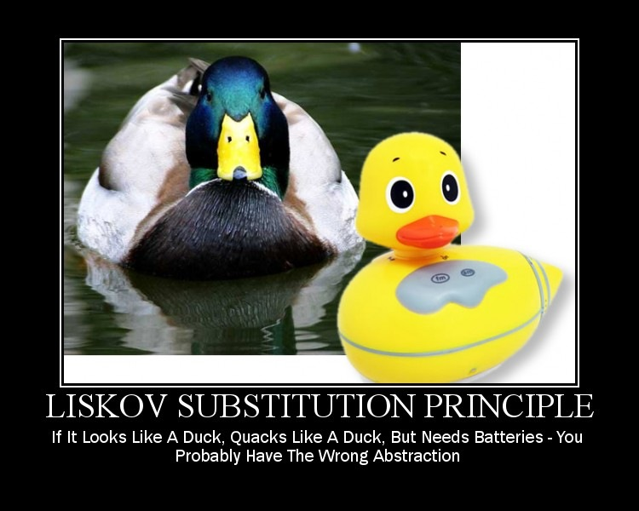
LSP

Slide 17
4. Inheritance
“Is-a” rule of inheritance
„Do not make a class B inherit from a class A unless you can somehow make the argument that one can view every instance of B also as an instance of A.”
Inheritance vs. relations
How not to use inheritance (car owner example)
“Is-a” rule vs. “Has-a” relation
The rule of change – if inherited can not be changed
Relation between classes, not objects
Notes:
“Is-a” rule of inheritance
Does TypeB only want only some/part of the behavior exposed by TypeA? Indicates need forComposition.
Does TypeB want to expose the complete interface (all public methods no less) of TypeA such that TypeB can be used where TypeA is expected? Indicates Inheritance.
Rule of change Do not use inheritance to describe a perceived "is-a" relation if the corresponding object components may have to be changed at run time. Inheritance should only be used if the corresponding inter-object relation is permanent.

Slide 18
Inheritance – change rule
Passenger
Occasional
Traveler
Frequent Flyer
Passenger
Miles state
OT state
FF state

Slide 19
Using inheritance well
Taxomania rule
Every heir must introduce a feature, redeclare an inherited feature, or add an invariant clause
Inheritance categories
Subtype inheritance (polygon, rectangle, …)
Implementation and Reification inheritance (collections)
Restriction and Extension (FfState–OtState, point-circle)
Facility inheritance (constant and machine)
Notes:
Taxomania rule
Every heir must introduce a feature, redeclare an inherited feature, or add an invariant clause.
Inheritance Simplicity rule
A use of inheritance should preferably belong to just one of the accepted categories.
Faciltiy
why we want the marriage: pure, greedy self-interest. We see a class with advantageous features and we want to use them.

Slide 20
General principles in detail
Law of Demeter
Constraints on what objects you should send messages to
Objects you should send messages
To the this object (or self)
To a parameter of the method
To an attribute of this (or an element of a collection)
To an object created within the method
You should NOT
Invoke methods on objects returned (chain of getters)
Notes:
Law of Demeter places constraints on what objects you should send messages to within a method. It states that within a method, messages should only be sent to the following objects:
The this object (or self).
A parameter of the method.
An attribute of this.
An element of a collection which is an attribute of this.
An object created within the method.
The intent is to avoid coupling a client to knowledge of indirect objects and the object connections between objects.
In other words, avoid chaining within a method because it creates a higher degree of coupling: sale.getPayment().getAmount();

Slide 21
General principles in detail
KISS – keep it simple
systems work best if they are kept simple rather than made complex
everything should be made as simple as possible, but no simpler – Albert Einstein
YAGNI - You ain't gonna need it
should not add functionality until it is necessar
Instead spend time on testing
software becomes larger and more complicated
Notes:
Law of Demeter places constraints on what objects you should send messages to within a method. It states that within a method, messages should only be sent to the following objects:
The this object (or self).
A parameter of the method.
An attribute of this.
An element of a collection which is an attribute of this.
An object created within the method.
The intent is to avoid coupling a client to knowledge of indirect objects and the object connections between objects.
In other words, avoid chaining within a method because it creates a higher degree of coupling: sale.getPayment().getAmount();

Slide 22
General principles in detail
Open closed principle
Software entities (classes, modules, methods) should be open for extension, but closed for modification
Modules never change, they are only extended
Relation to other concepts
Makes sense with Liskov’s substitution principle
Implemented by keeping dependency inversion principle
Might conflict with the KISS principle
Notes:
Open Closed Principle encourages software developers to design and write code in a fashion that adding new functionality would involve minimal changes to existing code. Most changes will be handled as new methods and new classes. Designs following this principle would result in resilient code which does not break on addition of new functionality.
When a single change to a program results in a cascade of changes to dependent modules, that program exhibits the undesirable attributes that we have come to associate with “bad” design. The program becomes fragile, rigid, unpredictable and unreusable. The open closed principle attacks this in a very straightforward way. It says that you should design modules that never change. When requirements change, you extend the behavior of such modules by adding new code, not by changing old code that already works.

Slide 23
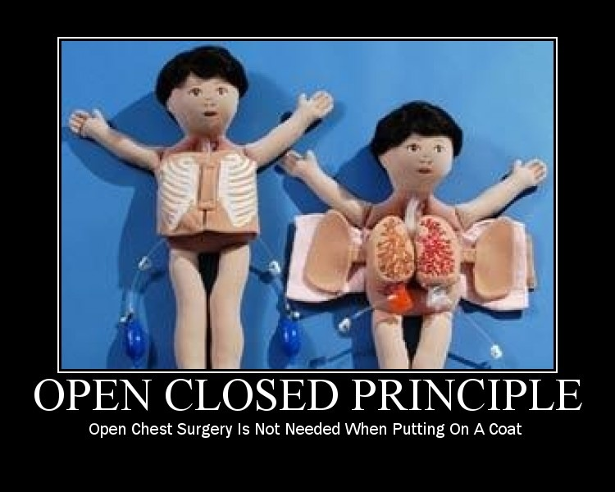
OCP

Slide 24
General principles in detail
Open closed principle
Rules to be kept
High cohesion and low coupling
Member variables must be private (encapsulation)
Only final global variables
No run-time type checking (no switch on enums)
Notes:
Member variables must be private
In OOD, we expect that the methods of a class are not closed to changes in the member variables of that class. However we do expect that any other class, including subclasses are closed against changes to those variables.
Only final global variables
No module that depends upon a global variable can be closed against any other module that might write to that variable.

Slide 25
General principles in detail
Interface segregation principle
Clients should not be forced to depend upon interfaces that they do not use
Applicable for classes having non-cohesive interfaces
Separates the view for different clients
Ensures low coupling between clients

Slide 26
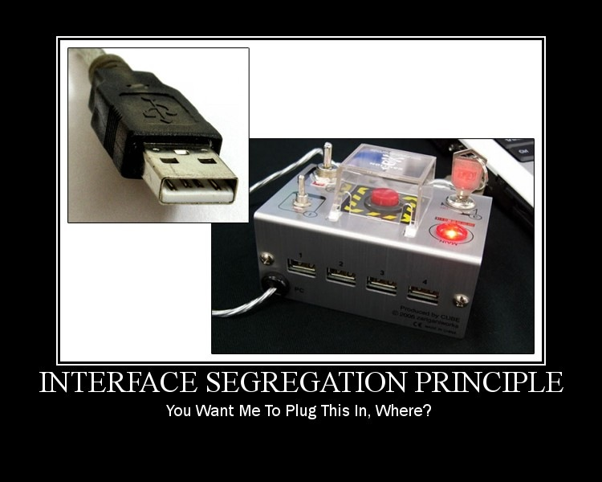
ISP

Slide 27
SOLID
Single responsibility
Open-closed
Liskov substitution
Interface segregation
Dependency inversion

Slide 28
Packaging
Associations – introduction of complexity
Implementing traversal operation
Mapping associations to DB relations
Maintaining consistency
Modules – reduction of complexity
Module is embraceable part of the system
The system is embraceable by relationship of the modules
High cohesion, low coupling (large-scale components)
Implement one conceptual object in one module

Slide 29
Relationship between objects - Aggregates
Boundary
Set of related entities inside the aggregate
Invariants (constraints) are maintained (transaction)
Created and deleted as a whole

Slide 30
Granularity
The Common Closure Principle
The classes in a package should be closed together against the same kind of changes.
A package should not have multiple reason to change
Maintability is often more important than reusability
Notes:
http://www.objectmentor.com/resources/articles/granularity.pdf
http://staff.cs.utu.fi/~jounsmed/doos_06/slides/slides_060404.pdf

Slide 31
Granularity
The Acyclic Dependencies Principle
Package graph should be DAG
Packages in a cycle will becomes de facto a single pakage
Solution 1: apply dependency inversion principle
Solution 2: Create a new package which is depended upon by both packages

Slide 32
Stability
The Stable Dependencies Principle
Depend in the direction of stability
Stable = not easy to change
Metrics:
Affarent coupling (Ca), Efferent coupling (Ce)
Instability I = Ce / (Ca + Ce)
The I metrics of a package should be larger than the I metrics of the package that depends on
Notes:
http://www.objectmentor.com/resources/articles/stability.pdf
Affarent coupling:
Numbers of classes outside of this package that depend on classes within this package
Efferent coupling:
Numbers of classes inside of this package that depend on classes outside this package
I = 1 max instable package
I = 0 max stable package

Slide 33
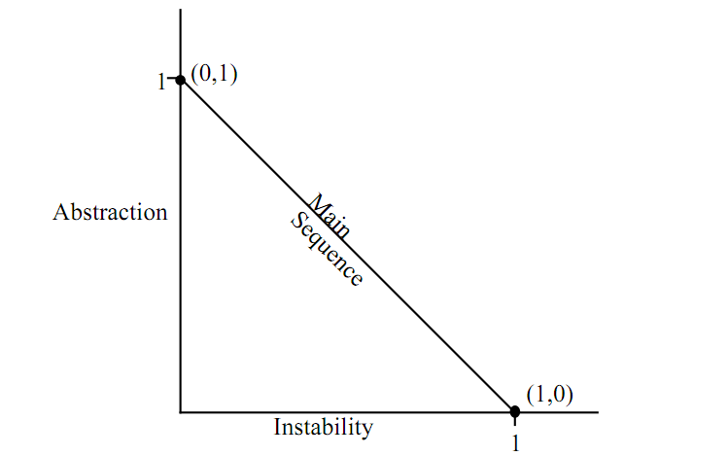
Stability
The Stable Abstractions Principle
A stable package should be abstract
An instable package should be concrete

Slide 34
Object-oriented Principles
For more information, please contact:
Bence Oláh
Title
EPAM Systems, Inc.
Address City, State, Zip Code Phone:
Fax:
Email:
http://www.epam.com

